Slide 1


High uptake and sustained impact on HIV-1 incidence: final results of an open-label extension trial of the dapivirine ring
Jared Baeten, Thesla Palanee-Phillips, Nyaradzo Mgodi, Gita Ramjee, Brenda Gati, Felix Mhlanga, Portia Hunidzarira, Leila E. Mansoor, Samantha Siva, Vaneshree Govender, Bonus Makanani, Logashvari Naidoo, Nishanta Singh, Gonasagrie Nair, Lameck Chinula, Ashley J. Mayo, Daniel Szydlo, Lydia Soto-Torres, Annalene Nel, Zeda Rosenberg, Sharon Hillier, Elizabeth Brown, MTN-025/HOPE Study Team
IAS 2019, Mexico City

Slide 2

Conflict of interest
I have received research funding for PrEP, ART for HIV prevention, and microbicides from the Bill & Melinda Gates Foundation, the US NIH, and USAID.
For some research studies, medication has been donated by Gilead Sciences and the International Partnership for Microbicides. I have served on Advisory Committees for Gilead Sciences, Merck, and Janssen.
I have no other conflicts of interest.

Slide 3

Background
The dapivirine vaginal ring is a flexible silicone matrix ring containing 25 mg of dapivirine, an HIV-1 non-nucleoside reverse transcriptase inhibitor.
Dapivirine is slowly released from the ring when placed in the vagina, and
the ring is replaced monthly with continuous use.

Slide 4




Background
Two phase III clinical trials – MTN-020/ASPIRE and IPM 027/The Ring Study – showed that the monthly dapivirine vaginal ring was well tolerated and reduced HIV-1 incidence by approximately 30% compared to placebo.
27%
reduction
31%
reduction
Baeten et al., Nel et al., NEJM 2016

Slide 5


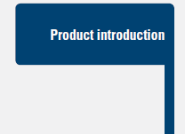

Open-label extension studies
For new HIV-1 prevention strategies, the pathway from clinical trial proof of efficacy to implementation often passes through open-label extensions
  providing early access to the effective product for those who had participated in the clinical trial
  exploring use of the product in the context of known clinical efficacy
  bridging to potential licensure & delivery at scale
Graphic: AVAC

Slide 6
MTN-025/HOPE
  MTN-025/HOPE was a multi-center open-label extension study (a phase IIIb trial) of the dapivirine vaginal ring (25 mg, replaced monthly).
  The population was HIV-1 uninfected women who had previously participated in MTN-020/ASPIRE.
  The primary objectives of MTN-025/HOPE were to assess adherence and safety in an open-label setting.
  Secondary objectives included assessing HIV-1 incidence and HIV-1 antiretroviral resistance.

Slide 7
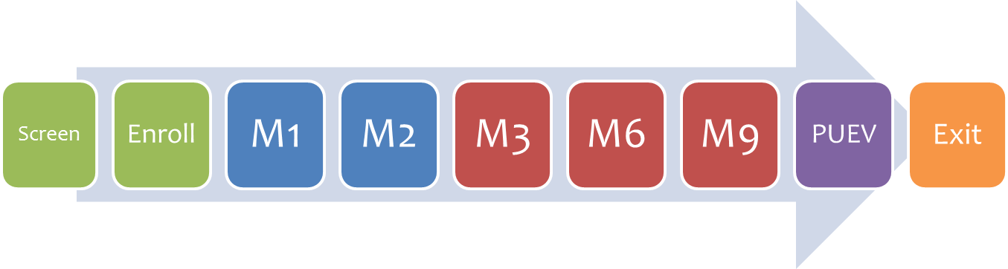
Design
Follow-up was for 12 months. Monthly for the first three months, then quarterly thereafter
    Transitioning to a more “real world” frequency for follow-up and distribution of rings
Using the ring was a choice. At every visit, women could choose to accept or decline the dapivirine vaginal ring and still continue in the study.
Study procedures were comprehensive. HIV testing, risk-reduction counseling, pregnancy testing, contraceptive counseling/provision, safety monitoring, product counseling/provision

Slide 8
Timeline
  MTN-020/ASPIRE reported its primary results in February 2016
  MTN-025/HOPE began in August 2016
  Enrollment into MTN-025/HOPE concluded in September 2017
  MTN-025/HOPE follow-up concluded in October 2018

Slide 9

Enrollment
2629 women participated in MTN-020/ASPIRE
  171 acquired HIV-1 during follow-up
For MTN-025/HOPE, 1643 women were screened and 1456 women were enrolled, 59% of those HIV-1 uninfected at the completion of MTN-020/ASPIRE.
  Most common reasons for not enrolling were having acquired HIV-1 (30%) & wanting to become pregnant (29%)
Participants were from 14 sites in 4 countries:
  Malawi (n=157, 11%)
  South Africa (n=707, 49%)
  Uganda (n=172, 12%)
  Zimbabwe (n=420, 29%)

Slide 10
Participant characteristics
Participant characteristics defined a population at risk for HIV-1:
Characteristics at study entry | MTN-025 HOPE
Age, median | 31 (range 20-49)
Age, <25 years | 12%
Married | 47%
Sexually transmitted infection (GC/CT/TV/TP) | 16%
Used a condom with last sex act | 43%

Slide 11
Participant characteristics
Participant characteristics defined a population at risk for HIV-1
Although population characteristics had expectedly evolved since enrollment into MTN-020/ASPIRE
Characteristics at study entry | MTN-025 HOPE | MTN-020 ASPIRE
Age, median | 31 (range 20-49) | 26 (range 18-45)
Age, <25 years | 12% | 39%
Married | 47% | 41%
Sexually transmitted infection (GC/CT/TV/TP) | 16% | 21%
Used a condom with last sex act | 43% | 57%

Slide 12
Retention and Follow-up
Retention was very high - 98% of expected visits were completed (vs. 91% in MTN-020/ASPIRE).
A total of 8436 follow-up visits were completed.
MTN-025 Visit Month | Retention, n (%)
Month 1 | 1428 (98%)
Month 2 | 1422 (98%)
Month 3 | 1427 (99%)
Month 6 | 1404 (98%)
Month 9 | 1379 (97%)
Month 12 | 1376 (97%)

Slide 13
Ring Uptake
At enrollment, 1342 women (92%) accepted the dapivirine vaginal ring.
Persistence was high: the majority continued to accept the ring.
When declined, the most common reason was having chosen another HIV-1 prevention method.
73% of women (936/1279*) accepted the ring for
all 12 months of follow-up
(*excluding women who acquired HIV-1 or who had a medical reason to withhold the ring [e.g., pregnancy])
92%
90%
89%
87%
83%
79%

Slide 14
Ring Adherence (1)
Returned, used rings were tested for residual levels of dapivirine.
  Rings are manufactured with approximately 25 mg of dapivirine and release approximately 4 mg with a month of continuous use.
  The amount of dapivirine released was calculated.
  Rings that had released >0.9 mg were defined as indicating at least some adherence during the month (but not necessarily consistent use).

Slide 15
Ring Adherence (2)
Overall, 90% of returned rings had released >0.9 mg
The average dapivirine released was greater for MTN-025 compared to MTN-020
Dapivirine released from rings, limited to those women who participated in both MTN-020 & MTN-025
p<0.001
(GEE)

Slide 16
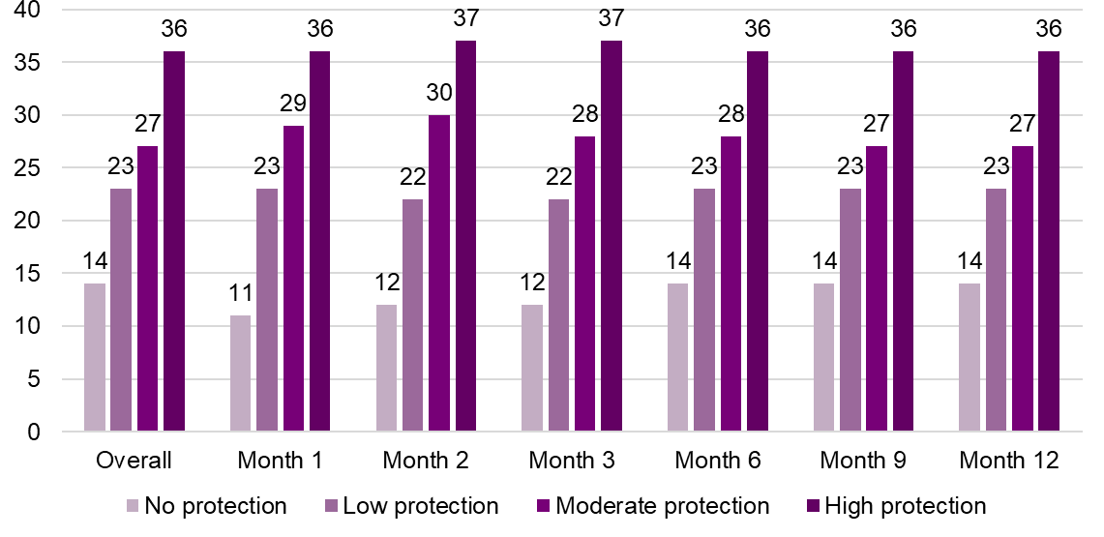
Ring Adherence (3)
Estimated use of the dapivirine vaginal ring remained relatively constant throughout follow-up
Relative level of HIV-1 protection | Average dapivirine released per month | Estimated level of HIV-1 protection (MTN-020/ASPIRE, Brown, AIDS 2016)
No | ≤1.4 mg | 11-20%
Low | 1.4 - 3 mg | 29-47%
Moderate | 3 - 3.9 mg | 58-75%
High | ≥3.9 mg | 47-92%

Slide 17
Safety
The frequency, severity, and type of adverse events observed was similar to that observed in MTN-020/ASPIRE – i.e., no new safety signal was seen
No SAE or Grade 3+ adverse event was assessed by the treating clinician to be related to the use of the dapivirine vaginal ring.
A total of 70 pregnancies occurred and had outcomes measured; no congenital anomalies were observed.
 | # (%) of participants
SAE | 20 (1%)
Grade 3+ event | 54 (4%)
Grade 2 event, related | 2 (<1%)

Slide 18
HIV-1 incidence
A total of 35 HIV-1 infections occurred, at an incidence of 2.7 per 100 person-years (95% CI 1.9-3.8)
This incidence is lower than the placebo arm incidence in MTN-020/ASPIRE which was 4.5 per 100 person-years (95% CI 3.7-5.5)
To compare HIV-1 incidence to that in MTN-020, while also accounting for differences between the populations, weighted bootstrap sampling of the placebo arm of MTN-020 was done, matched on trial site, age, and presence of a curable sexually transmitted infection at trial entry.

Slide 19
HIV-1 incidence comparison
The median HIV-1 incidence was 4.4 per 100 person-years in the 10,000 samplings from MTN-020/ASPIRE.
  An incidence of ≤2.7 would occur in <33/10,000 samplings
39% reduction
95%CI 14-65%
HIV-1 incidence = 4.4
(95% CI 3.2-5.8)
HIV-1 incidence = 2.7
(95% CI 1.9-3.8)
Placebo based on
MTN-020/ASPIRE
EXPECTED
MTN-025/HOPE
OBSERVED

Slide 20
HIV-1 antiretroviral resistance
Among the 35 infections, 7 had NNRTI mutations (4 K103N, 1 A98G, 1 E138A/V179D, 1 V106M/V179D), none of which suggest a dapivirine-specific resistance pattern

Slide 21
Summary
Final results from this open-label extension trial of the dapivirine vaginal ring indicate high uptake and adherence, a well-tolerated safety profile consistent with that seen in the phase III studies and lower HIV-1 incidence than expected.

Slide 22
Discussion
In MTN-025, women were offered the choice of the dapivirine vaginal ring – the vast majority initially accepted the ring and most continued throughout 12 months.
  This high level of persistence compares favorably to recent open-label studies of FTC/TDF PrEP among women
Comparing HIV-1 incidence in this study is limited:
  lack of a contemporaneous placebo group
  MTN-025 participants had not acquired HIV-1 during MTN-020
  not all women accepted or used the dapivirine vaginal ring

Slide 23
Conclusions
These results, along with those of a second open-label study called DREAM (presented at SA AIDS 2019), suggest interest in, adherence to, and HIV-1 risk reduction effectiveness of the dapivirine vaginal ring when used in an open-label setting, making the dapivirine vaginal ring a potential HIV-1 prevention option for women.

Slide 24



















MTN-025/HOPE Study Team
Leadership: Jared Baeten (protocol chair), Thesla Palanee-Phillips (protocol co-chair), Nyaradzo Mgodi (protocol co-chair), Elizabeth Brown (protocol statistician), Ashley Mayo (FHI 360), Lydia Soto-Torres (DAIDS medical officer)
Study sites:
  Malawi: Blantyre site (Malawi College of Medicine-John Hopkins University Research Project): Bonus Makanani, Taha Taha
  Malawi: Lilongwe site (University of North Carolina Project): Lameck Chinula
  South Africa: Cape Town site (University of Cape Town): Lulu Nair, Linda-Gail Bekker
  South Africa: Durban eThekwini site (Centre for AIDS Programme of Research in South Africa): Leila Mansoor
  South Africa: Durban – Botha’s Hill, Chatsworth, Isipingo, Tongaat, Verulam sites (South African Medical Research Council): Gita Ramjee, Anamika Premrajh, Dishiki Kalonji, Logashvari Naidoo, Nishanta Singh, Nitesha Jeenarain, Samantha Siva, Vaneshree Govender, Vimla Naicker, Zakir Gaffoor, Simone Hendricks, Shaamilah Suleman
  South Africa: Johannesburg site (Wits Reproductive Health and HIV Institute): Thesla Palanee-Phillips
  Uganda: Kampala site (Makerere University-Johns Hopkins University Research Collaboration): Brenda Gati, Clemensia Nakabiito
  Zimbabwe: Chitungwiza-Seke South, Chitungwiza-Zengeza, Harare-Spilhaus sites (University of Zimbabwe College of Health Sciences Clinical Trials Unit): Nyaradzo Mgodi, Felix Mhlanga, Portia Hunidzarira, Zvavahera Chirenje
Microbicides Trials Network Leadership and Operations Center (University of Pittsburgh, Magee-Womens Research Institute, University of Washington, FHI 360, New York State Psychiatry Institute, Population Council, RTI International): Sharon Hillier, Ivan Balan, Katherine Bunge, Morgan Garcia, Cindy Jacobson, Judith Jones, Ashley Mayo, Elizabeth Montgomery, Kenneth Ngure, Rachel Scheckter, Devika Singh, Kristine Torjesen, Ariane van der Straten, Rhonda White
Microbicides Trials Network Laboratory Center (Magee-Womens Research Institute, University of Pittsburgh, Johns Hopkins University): Craig Hendrix, Edward Livant, Mark Marzinke, John Mellors, Urvi Parikh
Microbicides Trials Network Statistical and Data Management Center (Fred Hutchinson Cancer Research Center): Elizabeth Brown, Jennifer Berthiaume, Marla Husnik, Karen Patterson, Melissa Peda, Daniel Szydlo
US National Institutes of Health: Nahida Chakhtoura, Donna Germuga, Diane Rausch, Lydia Soto-Torres
International Partnership for Microbicides: Zeda Rosenberg, Annalene Nel
ASPIRE & HOPE participants and their communities and Community Working Group
The International Partnership for Microbicides developed the dapivirine vaginal ring and provided the rings for this study. IPM receives generous support from the Danish Ministry of Foreign Affairs, Flanders Department of Foreign Affairs, Irish Aid, the German Federal Ministry of Education and Research (BMBF) through the KfW Development Bank, the Ministry of Foreign Affairs of the Netherlands, UK aid from the British people, the American people through the United States Agency for International Development (USAID) in partnership with the US President’s Emergency Plan for AIDS Relief (PEPFAR), and the Bill & Melinda Gates Foundation.
The Microbicide Trials Network is funded by the National Institute of Allergy and Infectious Diseases (UM1AI068633, UM1AI068615, UM1AI106707), with co-funding from the Eunice Kennedy Shriver National Institute of Child Health and Human Development and the National Institute of Mental Health, all components of the U.S. National Institutes of Health.

